Slide 1

Supervisor meeting, Thursday April 30th

Slide 2
Progress
What was discussed in the previous meeting:
‘Make a first version of your pipeline, just make it work’
What we did so far since previous meeting:
Implemented and improved necessary components within the pipeline to have it working (e.g. validation, simulation, reward). Zijian has also set up the RL loop which we can use for our next version.
Made agreements on formats to be used between steps
Tested the pipeline
Results?:
First version = successful!

Slide 3
First version overview
batch_id/LLM_output/*.net
validation_results.csv
Arbitrary LLM receives system prompt and generates batch of netlists
Validation algorithm goes over each topology using a checklist
Valid topologies are considered for simulation, necessary metrics are extracted from the simulation results.
simulation_results.csv
reward_results.csv
Generated topologies can be visualized
Extracted metrics are used to measure fitness score in reward function

Slide 4
System prompt
1 section and 2 preliminary sections:
### NAMING RULES: (fixed, explains the task and the naming rules to follow to the AI and what to generate, will be temporary as invalid checks will help update weights)
### CONSTRAINT: (presents the constraint set)
### REWARD: (RL-loopless approach, paste reward results below after 1st iteration to request improvement)

Slide 5
Validation Algorithm
Simulation parameters
Gate drive present
Gate per MOSFET
Connected graph
Floating nodes
Capacitor-inductor loops
Current path
Short: same node
Short: zero resistor
Short: zero voltage source
Singular voltage-capacitor loop
Short: input to GND
KVL voltage loop
Singular capacitor loop
Netlist syntax
Ground reference
Power supply
Naming conventions
Invalid components
Duplicate references
Component values
MOSFET bulk connection
Model declarations

Slide 6
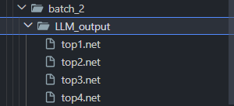
LLM output
We make use of a data folder, within this data folder, you have folders dedicated to each batch.
Within the batch folder (i.e. batch2/), the code created a llm_output/ folder and writes all netlists here.
The validation algorithm accesses this folder.

Slide 7
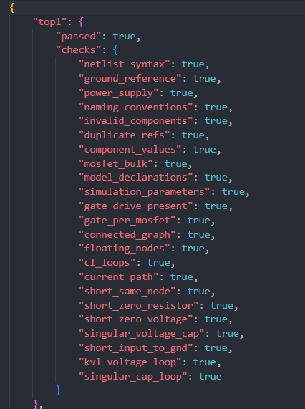
Validation output format
Circuits array
For each topology
Checks = true/false
Passed = if any false = false else true
Simulation code uses this output to filter
on topologies that have passed all checks

Slide 8
Simulation output format
.csv with simulation results of valid topologies
Each row is identified by first 2 columns: source_file (topology name) + step
e.g.
Top1, 0
Top1, 1
Top2, 0
Top3, 0
…

Slide 9
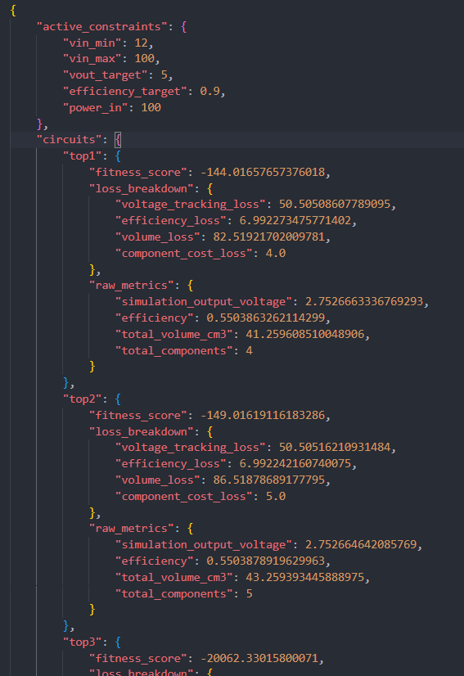
Reward output format
-constraint set
-circuit array
-> topology with
- fitness score
- detailed loss breakdown
- essential raw metrics from simulation

Slide 10
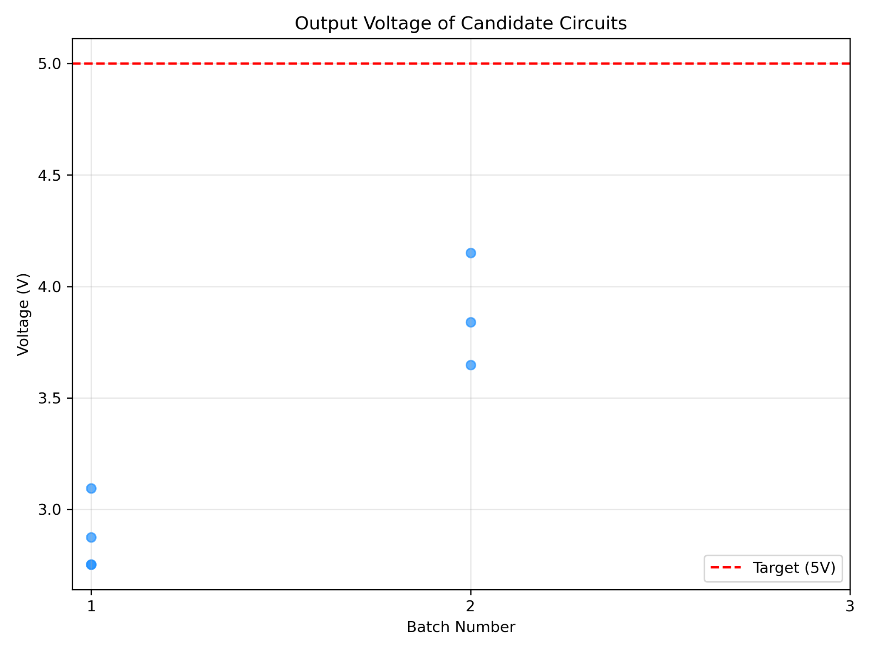
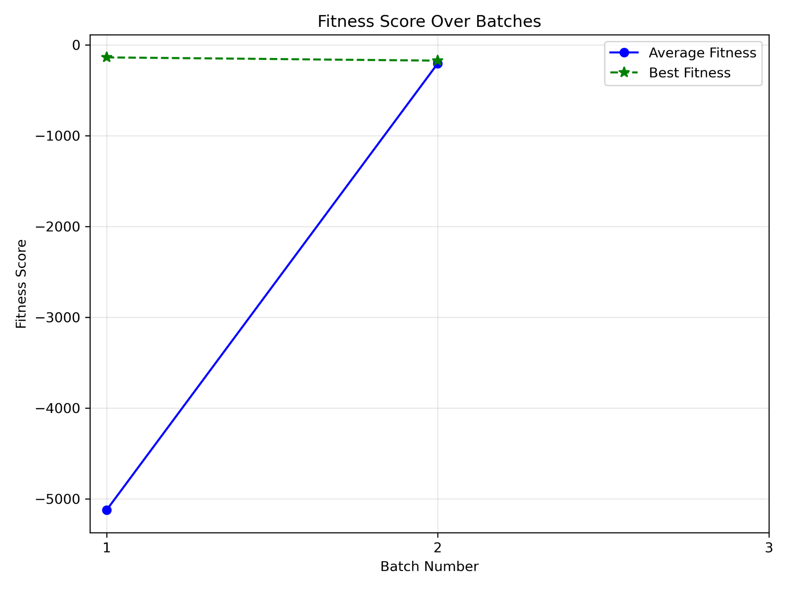
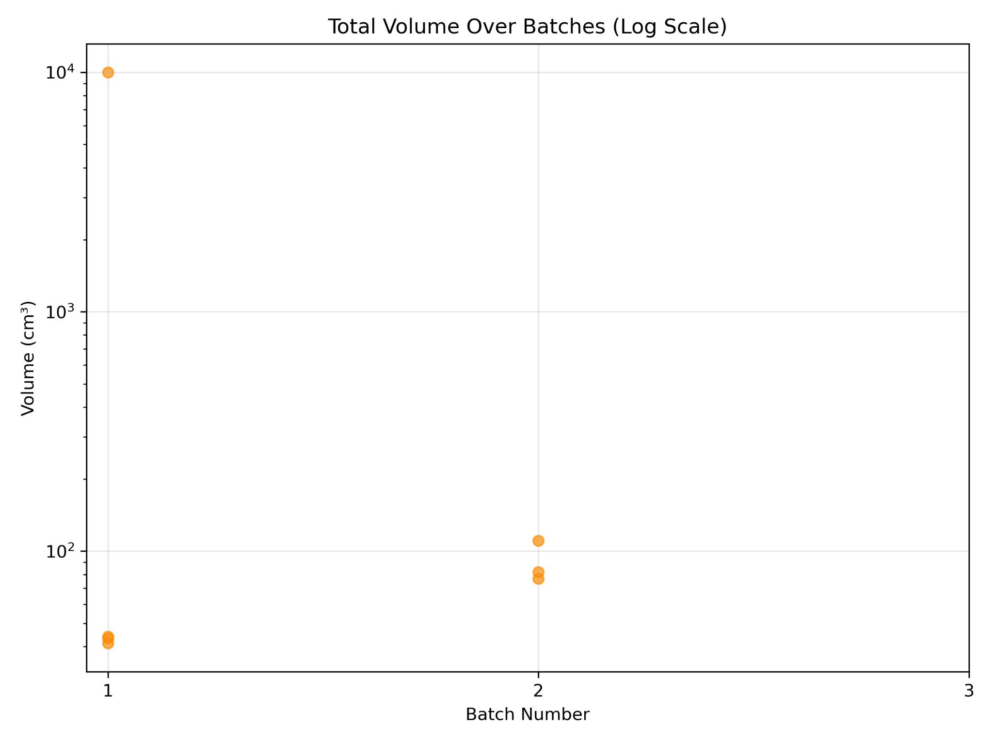
Results (3 iterations)

Slide 11
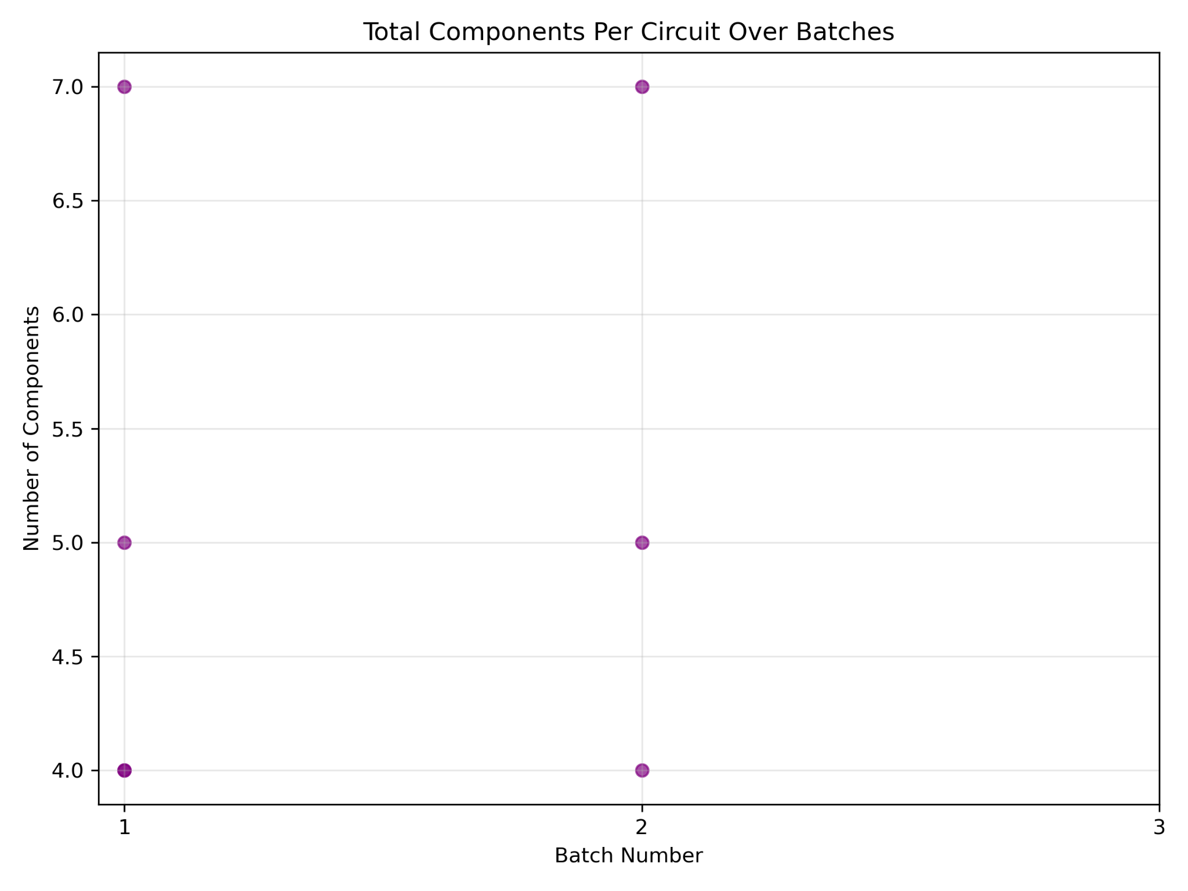
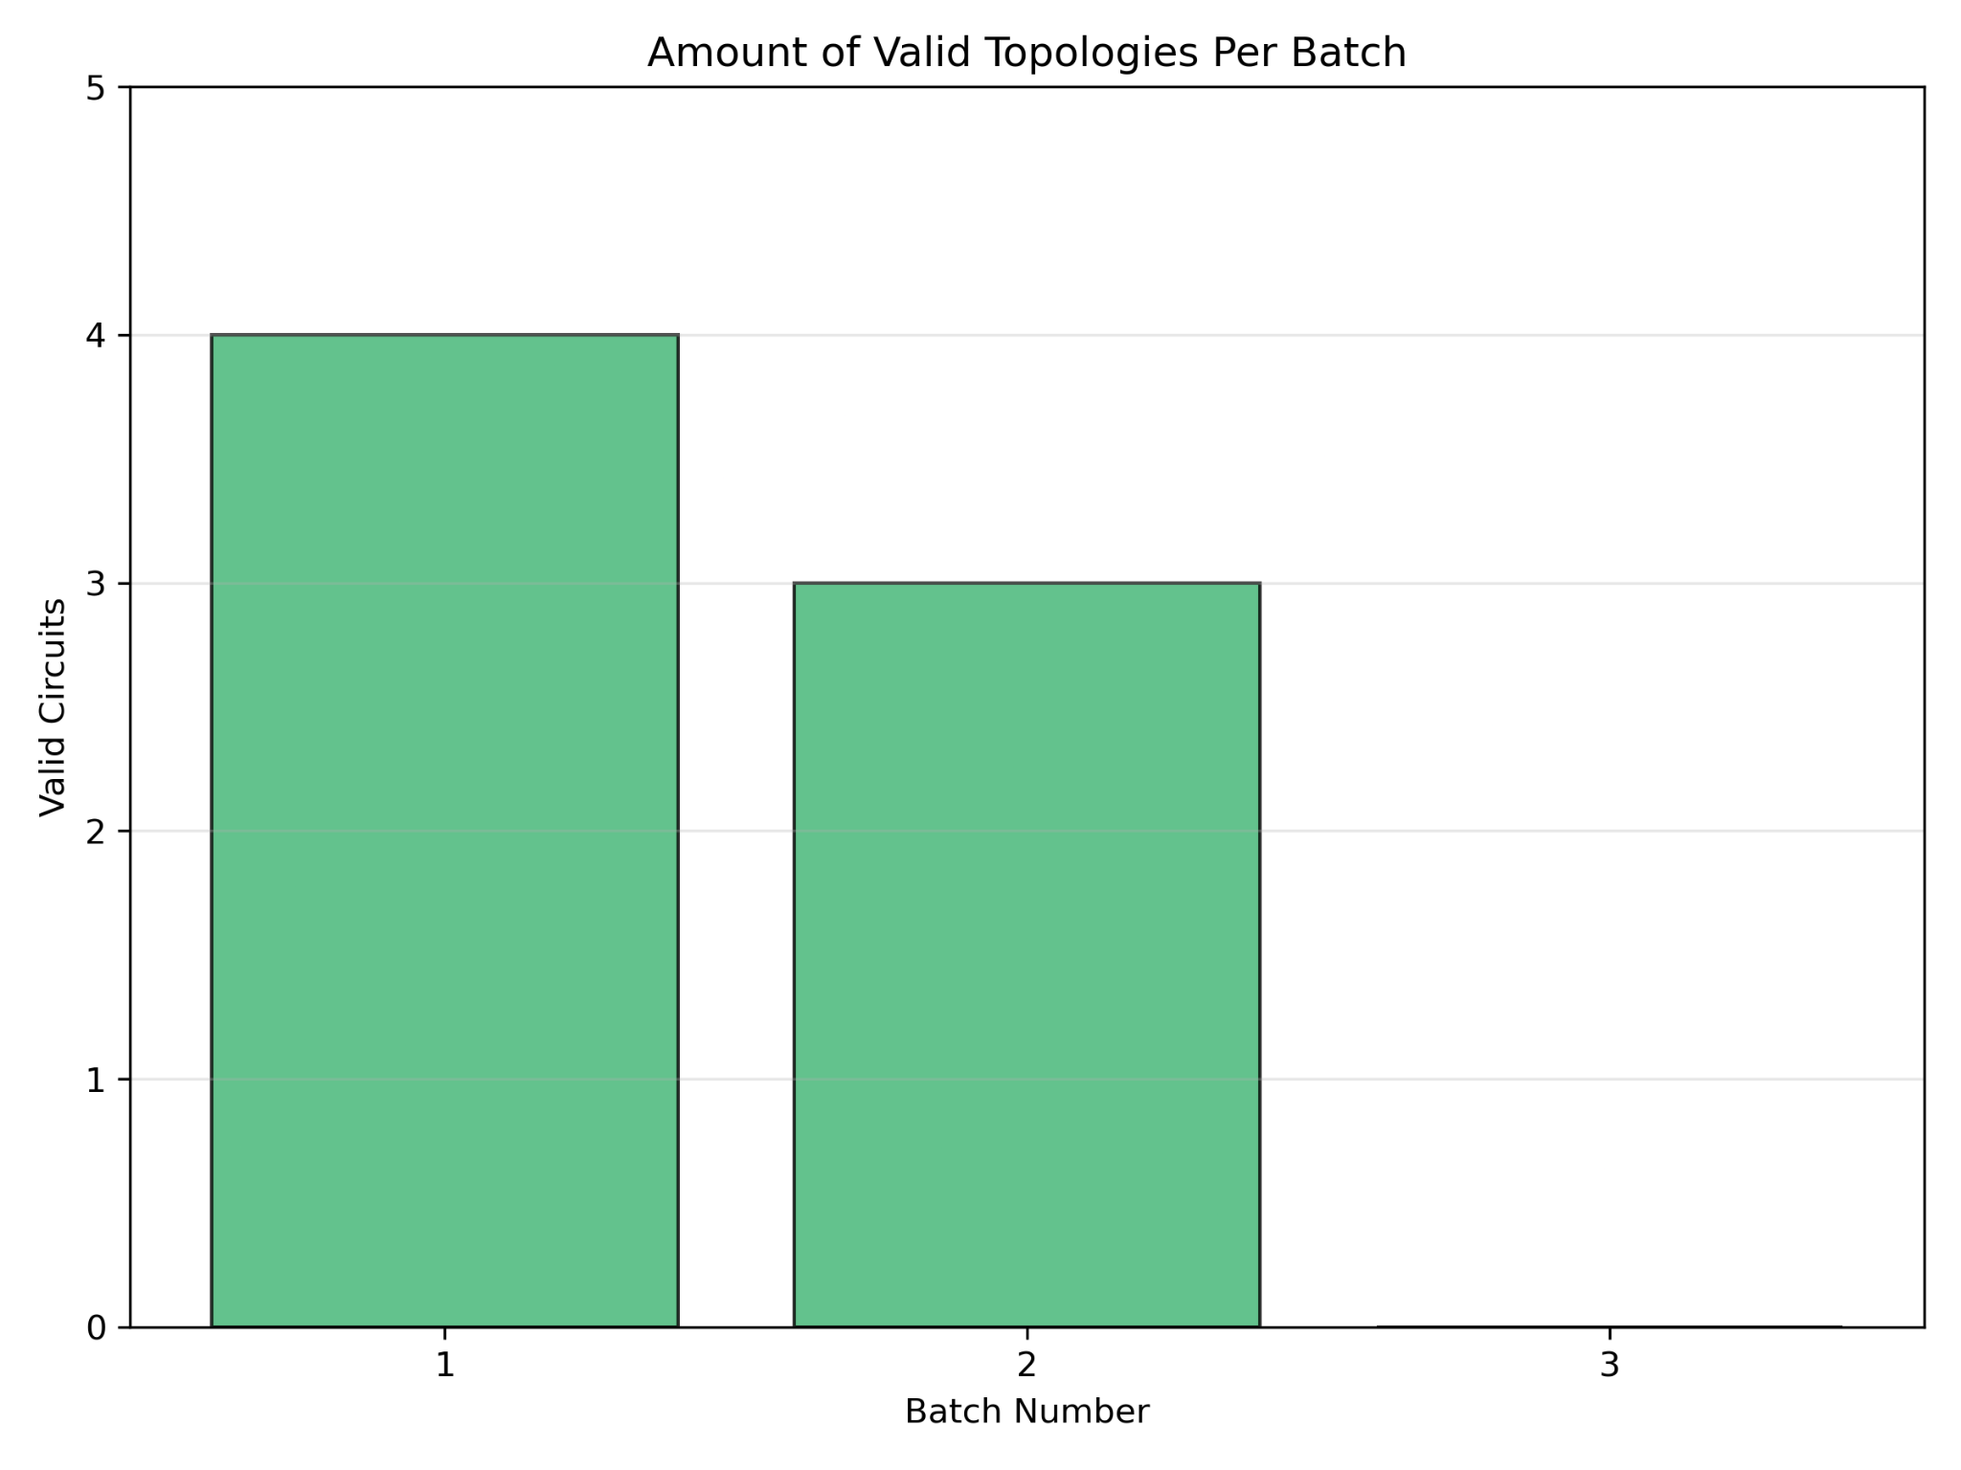

Slide 12
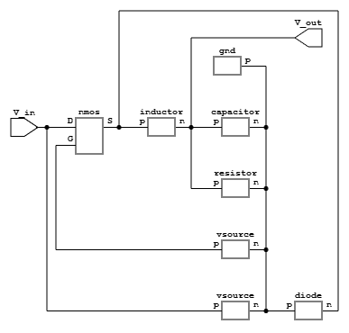
Topology schematics

